Slide 1
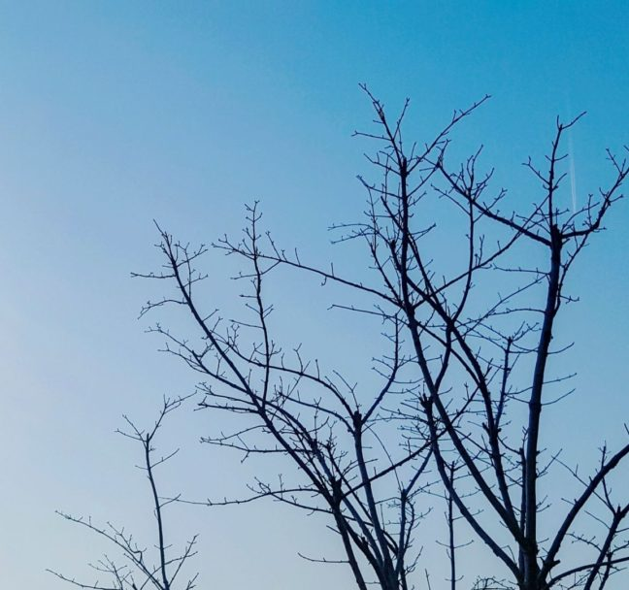
New York
Street Tree Analysis
Name: Boris Pikunov,
Dhiren Pagrani,
Adni Tahlil,
Fang-Chun Yeh
Date: 2021.Feb.20
Class ID: ALY6070 CRN 23203
Professor: Mykhaylo Trubskyy

Slide 2
1. Introduction
1. Introduction
2. Analysis
2.1 – Borough analytics
2.1.1 – Landscape
2.1.2 – Reward of tree guard
2.1.3 – Popular tree size
2.2 – Tree Species analytics
2.2.1 – water storage concern
2.2.2 – The most common tree species
2.2.3 – Side flag issue
2.3 – Tree Problem analytics
2.3.1 – The most urgent tree problems
2.3.2 – Stewardship activities
2.3.3 – Tree size and tree health relationship
3. Conclusion & Reference
The dataset used for this presentation is New York street tree dataset. The dataset contains 46 variables and 642,961 observations.
The variables include borough, data collected date, user who collected the data, tree status, tree species, tree problems, latitude and longitude of tree observations.
We are going to use this dataset to solve some business problems.

Slide 3
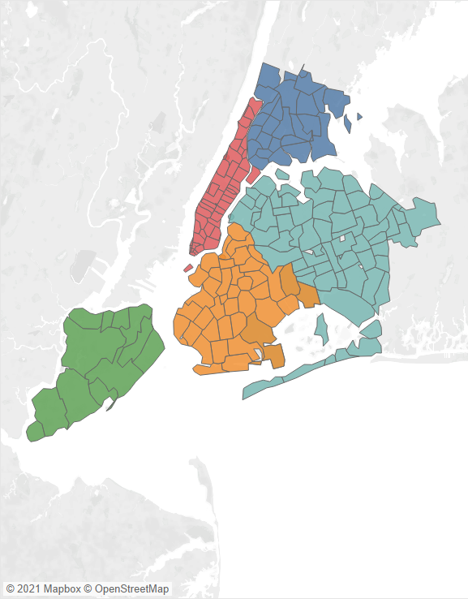
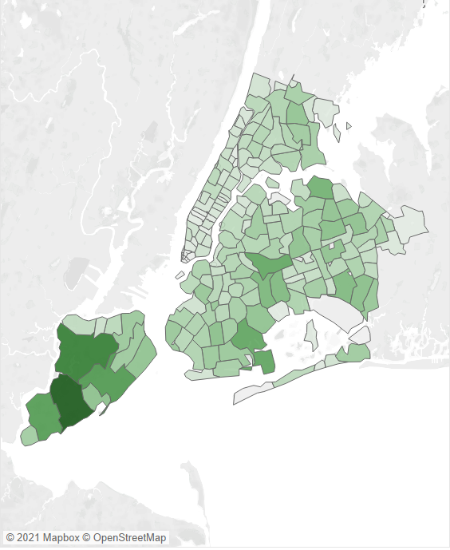
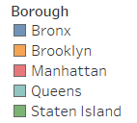

2. Analysis
2.1 Borough analysis
2.1.1 – Landscape
Business Question:
New York local government has a fund to landscape.
The government wants to know how to make citizens feel strongly that it landscapes the city.
Recommendation:
The tree density in Manhattan is much less than other boroughs. Planting street trees in Manhattan can make citizens feel the change the most.

Slide 4
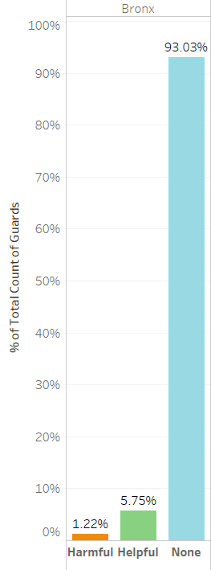
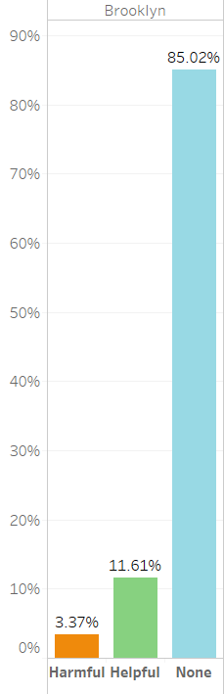
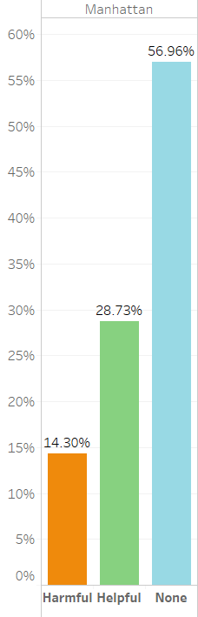
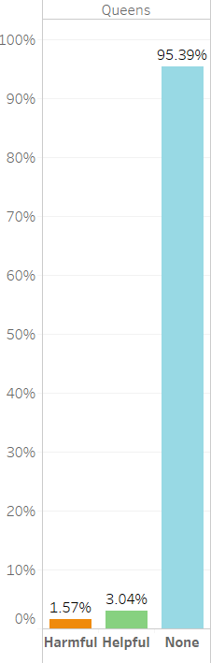
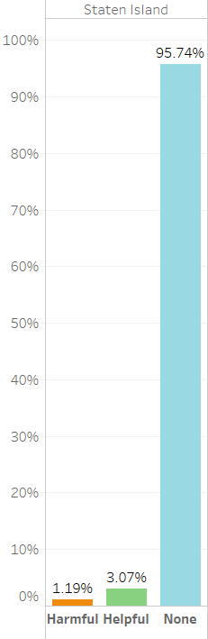
2. Analysis
2.1 Borough analysis
2.1.2 – Reward of tree guard
Business Question:
NYC state government wants to reward the borough which did the best job in guarding tree and by this way to encourage other boroughs to care this issue more.
Recommendation:
Manhattan should win the reward since its percentage of tree with no guard is significantly lower than other four boroughs, at 56%. The fact has reflected in its both higher harmful and helpful guard percentage.

Slide 5
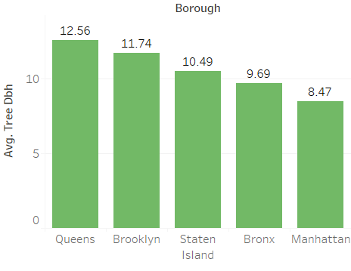
2. Analysis
2.1 Borough analysis
2.1.3 – Popular tree size
Business Question:
A tree businessman, Bezos, mainly sells large size trees. Which borough should he aim at?
Recommendation:
The bar chart left shows the average tree size in Queens is the largest. Queens is more likely to be suitable borough for big size trees and be a more potential market to Bezos.

Slide 6
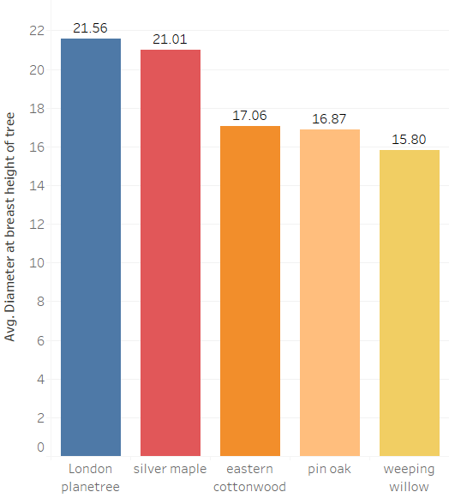
2. Analysis
2.2 Tree species analysis
2.2.1 – Water storage concern
Business Question:
Due to climate change, New York has faced land desertification problem in the future. Government thinks the issue may can address by planting trees.
Recommendation:
Trees with large trunk are considered having better water-storage ability. Therefore large trees like London Plane tree, Sliver Maple and Eastern Cottonwood are recommended to plant. Bezos should take the opportunity.
PS. The unit of the bar chart left is inch

Slide 7
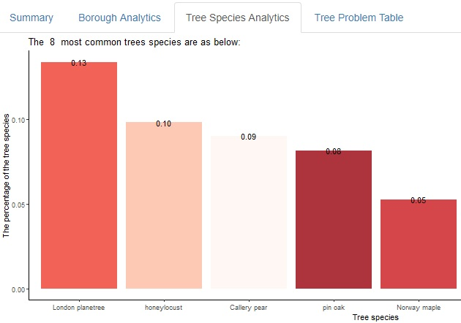
2. Analysis
2.2 Tree species analysis
2.2.2 – The most common tree species
Business Question:
Professor Mykhaylo is invited to give some planting advice to NYK park staffs. The planting advice for which tree species should the professor address?
Recommendation:
Since the most common street tree in New York are London Plane tree, Honey Locust and Callery Pear. Professor Mykhaylo should give NYK park staff more useful advice about these tree species.

Slide 8
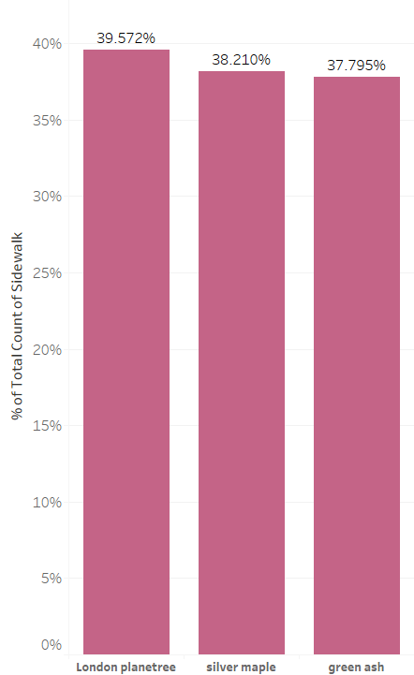
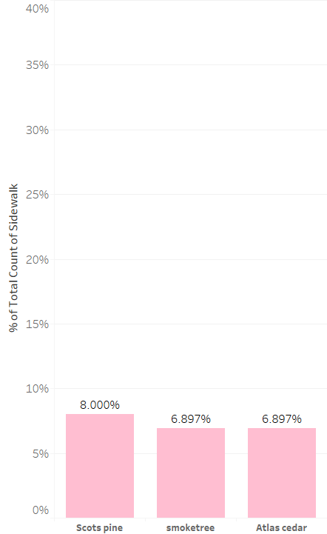
2. Analysis
2.2 Tree species analysis
2.2.3 – Side flag issue
Business Question:
More and more car accidents happened because of damaged sidewalk flags causing by street trees. Citizens want local government fix the problem as soon as possible.
Recommendation:
London Plane tree, Sliver maple and Green Ash are observed more Sidewalk damage. Recommend replace these tree species with Scots Pine, Smoke Tree and Atlas Cedar, which are observed causing less sidewalk problem.

Slide 9
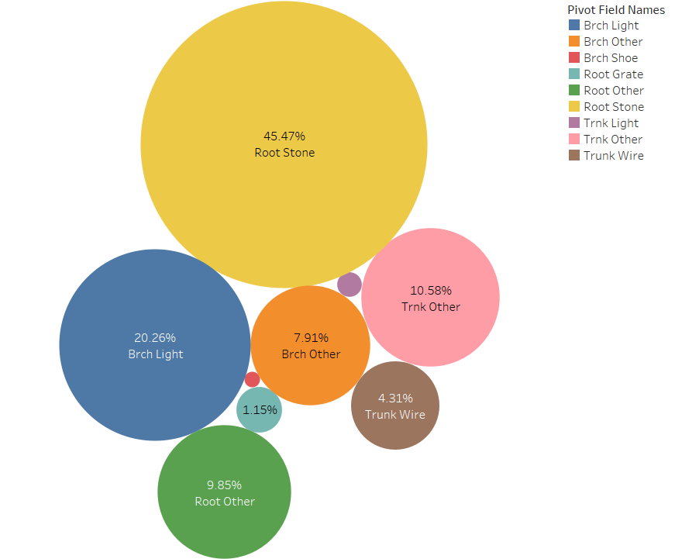
2. Analysis
2.3 Tree problem analysis
2.3.1 – The most urgent tree problems
Business Question:
Budget is limited, state government wants to use it to tackle the most serious tree problems.
Recommendation:
The most serious tree problems are root problem caused by paving stones in tree bed, branch problem caused by lights (usually string lights) or wires in the branches and other trunk problems.
State government can tackle tree problems in this order.

Slide 10
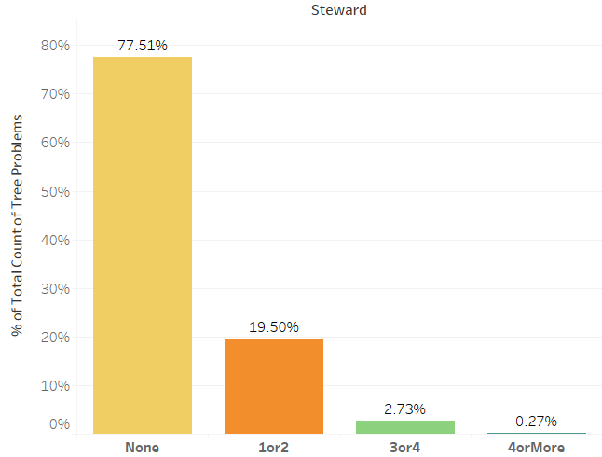
2. Analysis
2.3 Tree problem analysis
2.3.2 – Tree stewardship activities
Business Question:
NYC state government wants to evaluate the performance of stewardship activities, such as installing helpful tree guards, signs related to care of the tree or bed and seating in the tree bed, in terms of tackling tree problems.
Recommendation:
The bar chart left indicates that trees with more stewardship activities has significantly less proportion of tree problems. Therefore the performance of stewardship activities is good, government should conduct stewardship activities more if it wants to lower the proportion of tree problems.

Slide 11
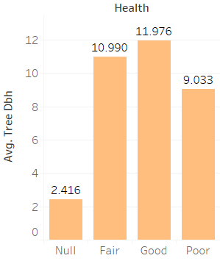
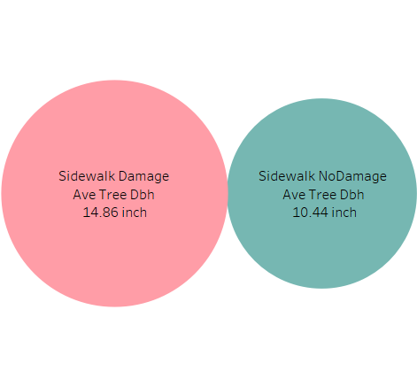
2. Analysis
2.3 Tree problem analysis
2.3.3 – Tree size and tree health relationship
Business Question:
Bezos has arrived Queens and he wants some suggestion about selling his trees to Queen’s street tree in charge.
Recommendation:
The suggestion for Bezos are that he could mention that larger trees are more likely in good condition and what he should not mention is that large trees are more likely to damage sidewalk.

Slide 12
3. Conclusion
Through borough analytics, we identify Manhattan as the borough which needs to landscape more and the borough did the best job in guarding trees.
Through tree species analytics, we found London Plane tree and Sliver Maple are two most thickest trees; London Plane tree and Honey Locust are two most common street trees; Smoke Tree and Atlas Cedar are two trees that least likely to damage side flags.
Through tree problems analytics, root problem caused by paving stones in tree bed is known as the most common tree problem. Stewardship can tackle tree problem effectively and larger trees are more likely to be in good condition.
Reference
NYC's Street trees. (n.d.). Retrieved February 19, 2021, from https://tree-map.nycgovparks.org/
2015 Street Tree Census Report, Retrieved from
http://media.nycgovparks.org/images/web/TreesCount/Index.html

